Slide 1
Data Analysis with Python
DARLENE WENDY NASIMIYU

Slide 2
Introduction to Data Analysis
Data analysis: The process of inspecting, cleansing, transforming and modelling data with the goal of discovering useful information, informing conclusion and support decision-making.
Traditional tools: Historically this was done using tools like Excel and Tableau.
Modern tools: Python, SQL, and other open-source libraries are revolutionizing the field.
Traditional Tools | Modern Tools
Microsoft Excel | Python (with Pandas, NumPy)
Tableau | SQL
SAS | R
SPSS | Jupyter Notebooks
IBM Cognos Analytics | Seaborn, Matplotlib
Oracle Business Intelligence | Google Colab

Slide 3
Why Use Python for Data Analysis?
Open-source and free.
Powerful libraries (Pandas, NumPy, Matplotlib, Seaborn).
Versatile: Handles various formats (CSV, SQL, Excel, etc.).
Widely adopted: Popular in the data science community.
R is used when:
When R is needed
When extreme performance is needed
Dealing with advanced statistical methods

Slide 4
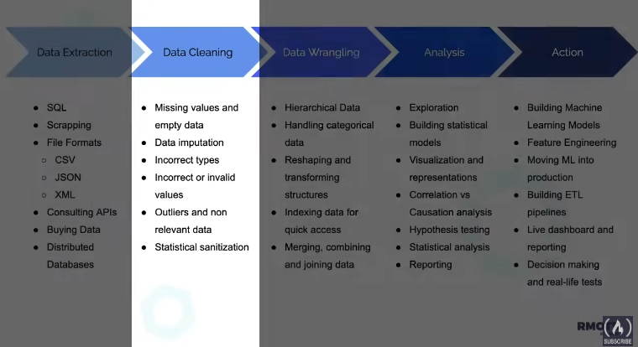
The Data Analysis Process
Extract Data: Collect data from various sources like databases, APIs, and files (e.g., CSV, JSON).
Clean Data: Handle missing values, correct errors, and remove irrelevant data to ensure accuracy.
Wrangle Data: Reshape, combine, and structure the data for easy analysis.
Analyze Data: Explore, model, and visualize the data to gain insights and test hypotheses.
Take Action: Build machine learning models, generate reports, and implement solutions based on findings.

Slide 5
Data Analysis vs Data Science
Data Analysis: Primarily focuses on exploring and examining existing data to uncover meaningful insights, trends, and patterns that can inform decision-making.
Data Science: Encompasses data analysis but goes beyond by incorporating advanced techniques such as predictive modeling, machine learning, and data engineering to build systems that can predict future outcomes and automate processes.
Python is a versatile programming language commonly used in both fields due to its powerful libraries and tools for data manipulation, analysis, and machine learning.

Slide 6
Real-Life Example: Python Data Analysis Project
Dataset name: Spotify Most Streamed Songs
Title: Analysis of the Most Streamed Songs on Spotify and Other Music Platforms.
This dataset includes information about popular songs on platforms like Spotify and Apple Music. It shows things like how many times a song was streamed, how often it appears in playlists, and its musical features (like how energetic or danceable it is). The goal is to understand what makes a song popular. By looking at the patterns between the song’s features and its success, this analysis can help artists and music producers know what makes a song more likely to be a hit.

Slide 7
Introduction to Jupyter Notebooks
Definition: Jupyter Notebooks are an interactive computing environment where you can write and execute code in a flexible, cell-based format.
Key Features:
Live Code: Allows users to write and run code, supporting multiple programming languages (Python, R, Julia, etc.).
Visualizations: Integrates visual output (graphs, charts) directly within the notebook.
Markdown Support: Users can create richly formatted documentation with text, headings, images, and links using Markdown.

Slide 8
Introduction to NumPy
Definition: This is a programming library in python that is used in statistical analysis and to work with large, multi-dimensional arrays and matrices.
It makes numerical computations fast and efficient, and serves as the base for other data libraries like Pandas and SciPy.
Key Features: Live Code: Allows users to write and run code, supporting multiple programming languages (Python, R, Julia, etc.).
Visualizations: Integrates visual output (graphs, charts) directly within the notebook.
Markdown Support: Users can create richly formatted documentation with text, headings, images, and links using Markdown.

Slide 9
Key Features of NumPy
Efficiency: NumPy is much faster than standard Python lists, especially for numerical and scientific tasks. It handles large amounts of data efficiently with lower memory usage.
Broadcasting: Simplifies complex mathematical operations by allowing arrays of different shapes to interact seamlessly. This reduces the need for manual alignment of data during operations.
Vectorization: Allows you to perform operations on entire arrays simultaneously without writing explicit loops, which enhances code readability and performance.

Slide 10
Introduction to Pandas
Definition: Pandas is a powerful, high-level data manipulation library built on top of NumPy, designed for easier data handling and analysis.
DataFrame: A two-dimensional, labeled data structure, similar to an Excel spreadsheet but far more versatile, allowing for more complex data manipulation tasks.
Series: A one-dimensional labeled array, ideal for handling a single column of data.

Slide 11
Working with Pandas: Key Functions
Pandas tends to offer powerful tools for data manipulation and analysis. Here are some key functions you’ll frequently use when working with Pandas:
• Loading Data: read_csv(), read_excel(), read_sql().
• Data Manipulation: df.head(), df.describe(), df.info().
• Filtering: df[df['column'] > value], selecting rows/columns by condition.
• Data Aggregation: Grouping data by category (groupby()).
Data Cleaning with pandas basically involves:
Missing Values: dropna(), fillna(), handling NaN values.
Type Conversion: astype() for converting column data types.
Duplicated Data: drop_duplicates() to remove redundant data.
Column Renaming: df.rename() to rename columns for clarity.

Slide 12
Difference between Pandas and Numpy
Feature | Pandas | NumPy
Data Structures | DataFrame (2D), Series (1D) | Arrays (multi-dimensional)
Use Case | Best for tabular data (structured) | Best for numerical computations
Handling Missing Data | Handles missing data with ease using NaN | Limited support for missing data
Labeling | Labeled axes (rows and columns) | No labels, works with index-based access
Data Types | Supports mixed data types (int, float, string) | Primarily for numerical data (int, float)
Flexibility | More flexible for data manipulation tasks | More specialized for performance on large arrays

Slide 13
Introduction to Data Visualization
Matplotlib is one of the most widely used Python libraries for creating basic visualizations such as line charts, bar charts, histograms, scatter plots, and more.
It offers a variety of customization options, allowing you to tweak colors, labels, axes, legends, and gridlines, making it highly flexible for representing data visually.
Matplotlib’s simplicity and vast feature set make it a great tool for visualizing both small datasets and more complex visualizations.

Slide 14
Advanced Visualizations with Seaborn
Seaborn is built on top of Matplotlib and is designed to provide more advanced, elegant, and aesthetically pleasing visualizations.
It excels in creating statistical plots like heatmaps, pair plots, violin plots, and more, offering high-level abstractions to work easily with complex datasets.
Seaborn’s default styles and color palettes allow you to create professional-quality visualizations quickly, and it integrates well with Pandas DataFrames for easier data handling.

Slide 15
Reading Data from Multiple Sources
Pandas provides powerful functions for reading data from various file formats and databases, making it easy to ingest and analyze different types of data.
You can use pd.read_csv() to read data from CSV files, pd.read_excel() for Excel spreadsheets, and pd.read_sql() to retrieve data directly from SQL databases.
These functions are highly customizable with options to handle missing data, specify delimiters, and process large datasets efficiently.

Slide 16
Writing Data Back to Files
Once your data analysis is complete, you can save your processed data back to various formats using Pandas’ to_* functions, such as to_csv(), to_excel(), and to_sql().
These functions allow you to write DataFrames to files, databases, or spreadsheets while maintaining control over file formatting, including options like whether to include the index, adjust delimiters, or specify sheet names for Excel.
For example, you can easily save your cleaned data to a CSV file for sharing or further processing with just one line of code.

Slide 17
Python Recap for Data Analysis
Python Fundamentals for Data Analysis
Control Flow: Python’s for loops, if-else conditionals, and functions allow you to automate repetitive tasks and add logic to your data analysis workflows.
Data Structures: Familiarize yourself with Python’s core data structures like lists, dictionaries, and tuples, which help you organize and manipulate data efficiently.
Error Handling: Python’s try-except blocks are essential for handling exceptions gracefully, ensuring your code doesn’t break during execution due to unexpected errors like missing files or invalid data.

Slide 18
References
freeCodeCamp.org. (2020). Data Analysis with Python - Full Course for Beginners (Numpy, Pandas, Matplotlib, Seaborn) [YouTube Video]. In YouTube. https://www.youtube.com/watch?v=r-uOLxNrNk8

